Slide 1

Software Development: Data Structures (H16Y35)
Lecture 11 :Python Dictionaries
c.nyssen@nescol.ac.uk © NESCOL 2020
some materials adapted © Dr Charles Severance, University of Michigan, 2013

Slide 2

Welcome to Data Structures (H16Y35) Week 11
Last week, we looked at Hash Tables, Sets and Maps. We saw that a Hashmap is another name for a Dictionary, which is a structure with key:value pairs; this week, we will have some practice with dictionaries.

Slide 3
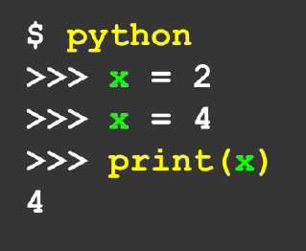
Collections (refresher)
The term “collection” means a container for more than one variable, that we can carry around in one convenient package. We have places “in” the container for each individual variable and we can refer to them by their places.
When we declare a variable, it has one value only in it; every time we redeclare it, the original value is overwritten.
Lists and Dictionaries are both collections.
A list is a linear collection of values that stay in order.
A dictionary is a “bag” of values, each with it’s own label.

Slide 4

Collections (refresher)
Dictionaries are Python’s most powerful data collection, and allow us to do fast database-type operations.
These have different names in different languages –
Associative Arrays (Perl, PHP)
Properties, Map, Hashmap (Java)
Property Bag (C#, .Net)
See https://en.wikipedia.org/wiki/Associative_array

Slide 5
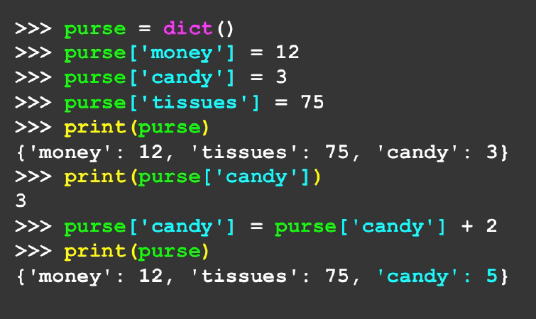
Collections (refresher)
Lists index things by their position in the list, dictionaries are like bags (no order).
This is because things are added in order of their hashed key, not in index order.
So we have to index things with a key, exactly like the hashtable.

Slide 6
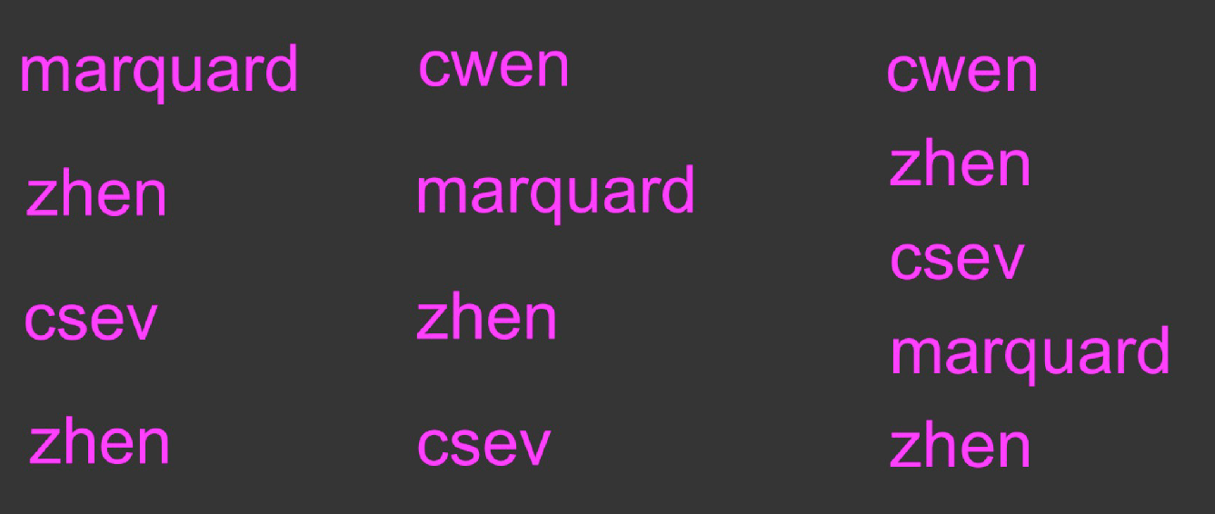
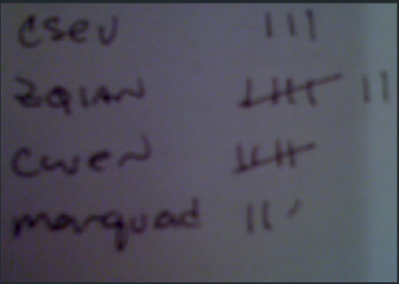
Some Common Uses of Dictionaries
A common use of dictionaries is to count things. For example, let’s say we have a server log that has a list of all the usernames logged in, and we want to see who has logged in the most often.
This example has only 12 entries, but a real server log may contain many millions of entries – so it makes sense to have something automatic…

Slide 7
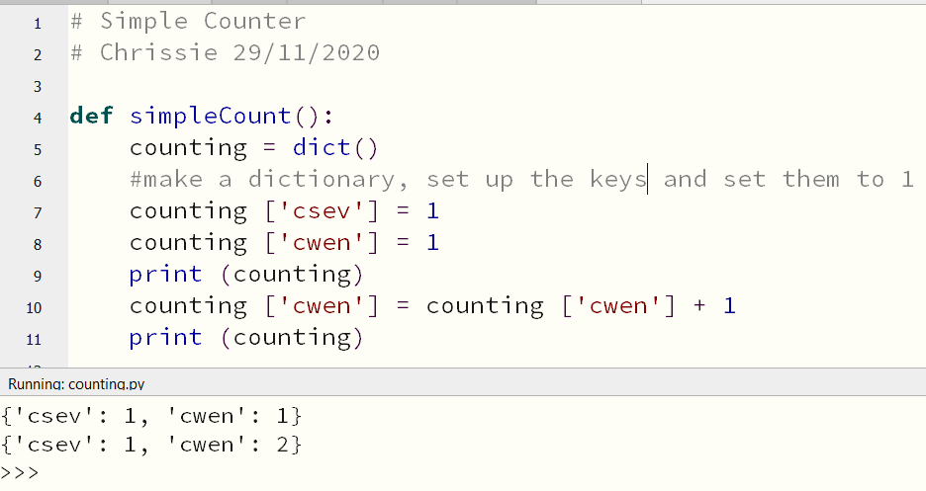
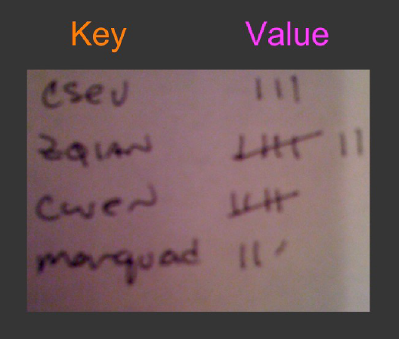
Dictionary as a Counter
A common use of a dictionary is for counting how often we “see” something.

Slide 8
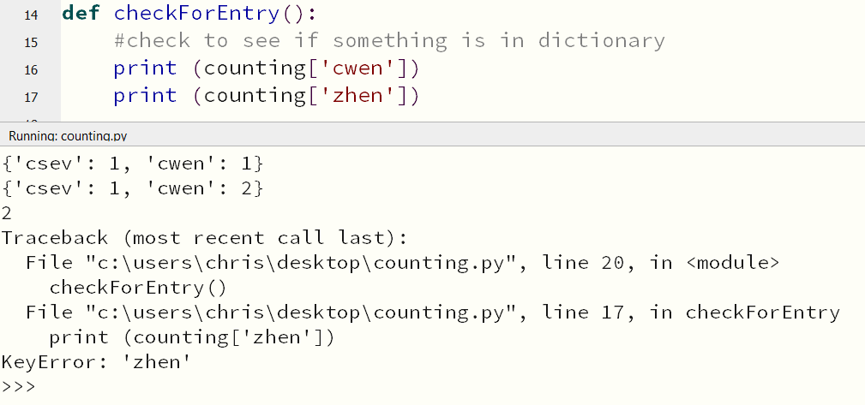
Dictionary as a Counter
However if we try to reference a non-existent key, we will encounter a traceback error….
So we use the in operator to check whether the key exists, before attempting to print it.

Slide 9
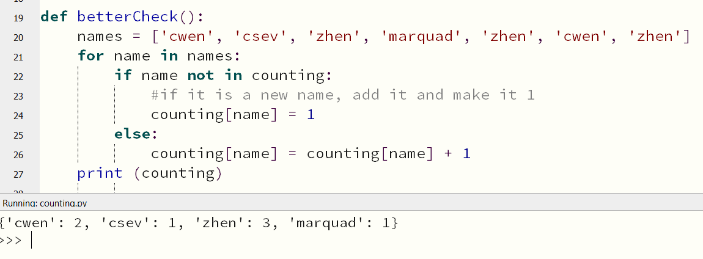
Dictionary as a Counter
Here, we have added all of the names as a list, then scrolled through the list, counting them. The count then becomes the value paired to the name key.
If we encounter a new name, we add it to the dictionary and set it to 1.

Slide 10
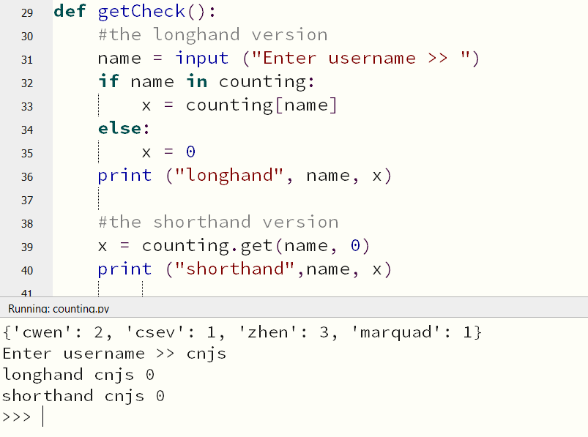
The get() Method For a Dictionary
The pattern of checking to see whether something is already in a dictionary, and returning a default if it is not, is so common that Python has a built-in method called get() to handle this – and it also returns a default, without a traceback, if the item is not found.

Slide 11
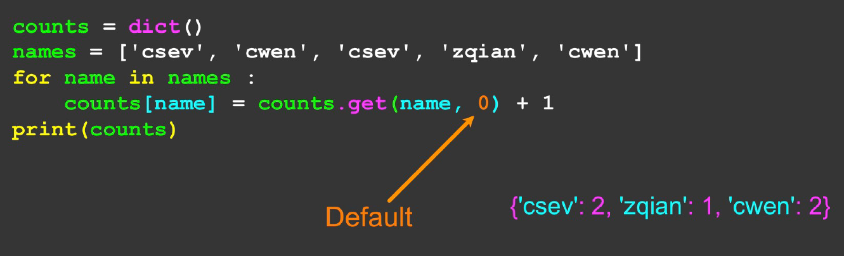
Simplified Counting With get()
We can also use get() and just provide a default value of 0 where the key is not yet in the dictionary – and just add one!
Useful video about counting here ;)

Slide 12
Dictionaries and Definite Loops
We saw last week that dictionaries are often built using hash tables. As the name suggests, hash tables rely on a concept called hashing, to ensure that each keyword is uniquely referred to in memory.
Unfortunately, however, this means that dictionaries are stored by the order of their hashed keys, and not in any order that makes sense to the user. This is why they are sometimes referred to as bag structures.

Slide 13
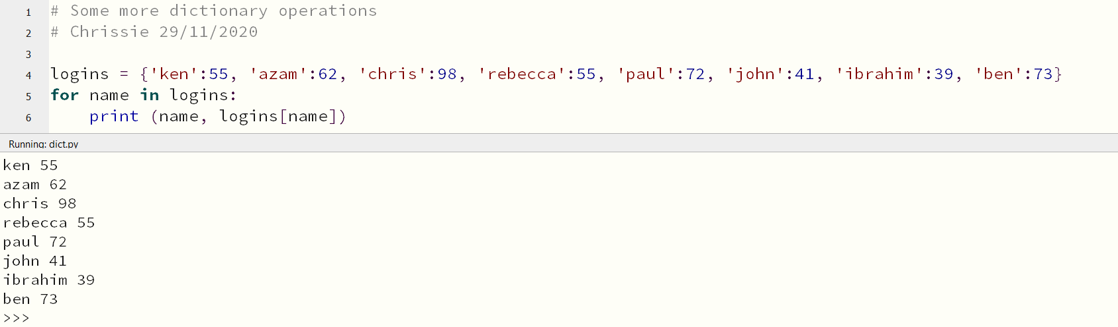
Retrieving Lists of Keys and Values
Even though dictionaries are not stored in an apparent order, we can still write a for loop that goes through all the entries in a dictionary – in actual fact it goes through all of the keys in the dictionary and looks up the corresponding values.

Slide 14
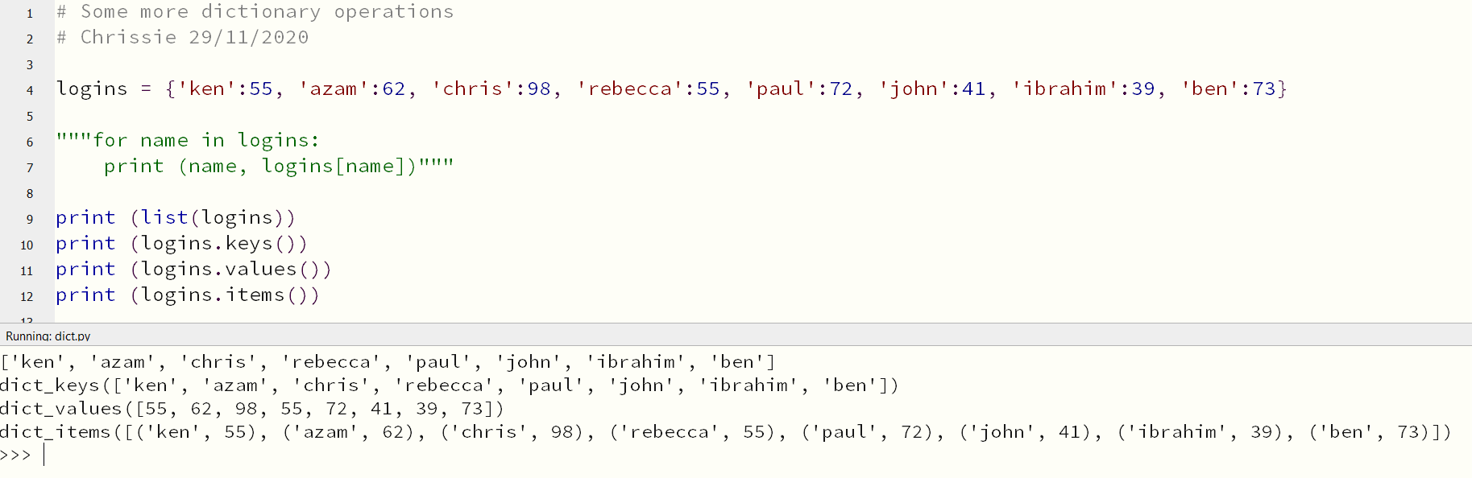
Retrieving Lists of Keys and Values
You can print lists of keys, or values, or both, from dictionaries, like this -
This is a structure called a tuple which is immutable, more about those in a wee minute

Slide 15
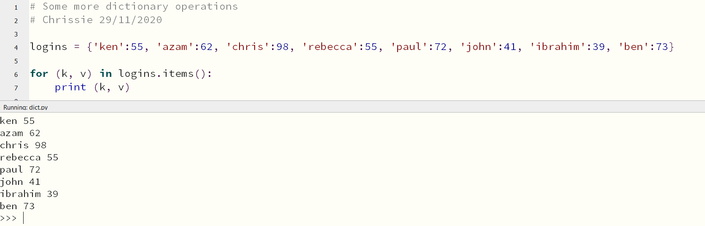
Retrieving Lists of Keys and Values
We saw in the last slide that the .items() operator returned a list of tuples.
To iterate over a list of tuples, we need two iterators (here I have used k and v to represent key and value).

Slide 16
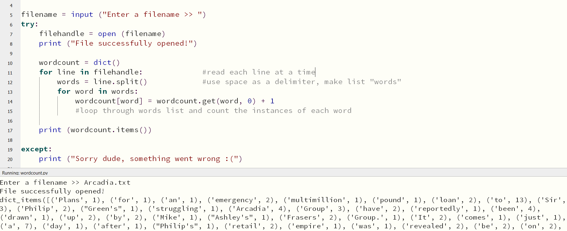
Dictionaries and File Operations
We can use Python’s file operations to open a file and count how many instances of each word there are ….

Slide 17
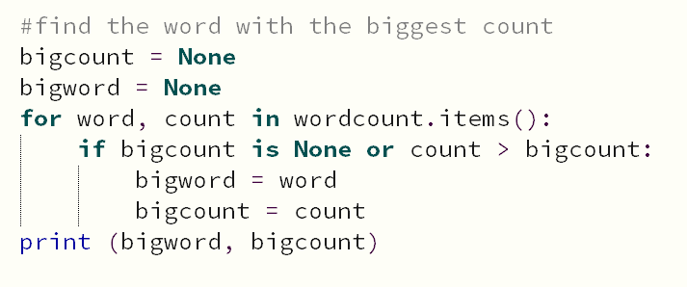
Dictionaries and File Operations
…and add this piece of code to count which word makes the most appearances!

Slide 18
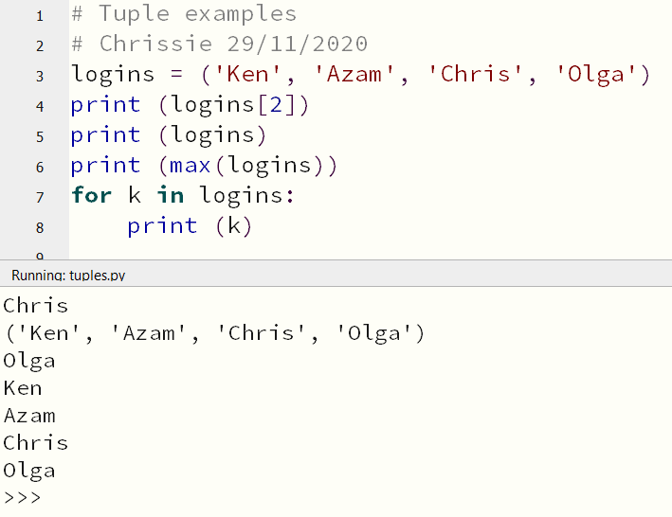
Can We Sort a Dictionary?
The answer to this is…. kind of.
We saw a couple of slides ago that the .items() operator returned a dictionary as a list of tuples.
A tuple is another kind of sequence in Python that behaves in the same way as a list, having indexed elements that start at 0.

Slide 19
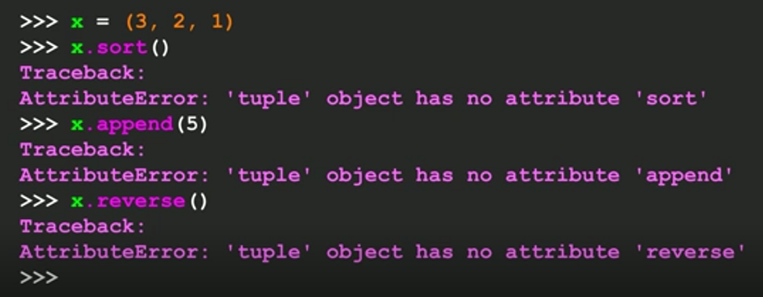
But Tuples Are Immutable….
Once you have created them, they are immutable, like a string. You can change the contents of a list, but not a tuple. You cannot sort, reverse or assign new values to a tuple (these will all result in traceback errors).
Tuples are, however, very efficient for Python to use; they require less memory and processing resources than lists do, so you should use them in place of lists wherever possible (especially if it is just a temporary variable).

Slide 20
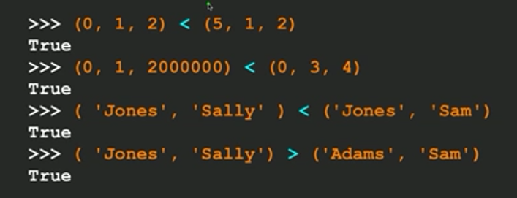
Tuples are Comparable
You can compare tuples – for example (255, 65, 132) and (55, 167, 43) and it will compare on the first value, i.e. the 255 and the 55. If the first two elements are equal, it goes on to the second element, and so on, until it finds two elements that differ.
We can now exploit this to sort our list of dictionary tuples.

Slide 21
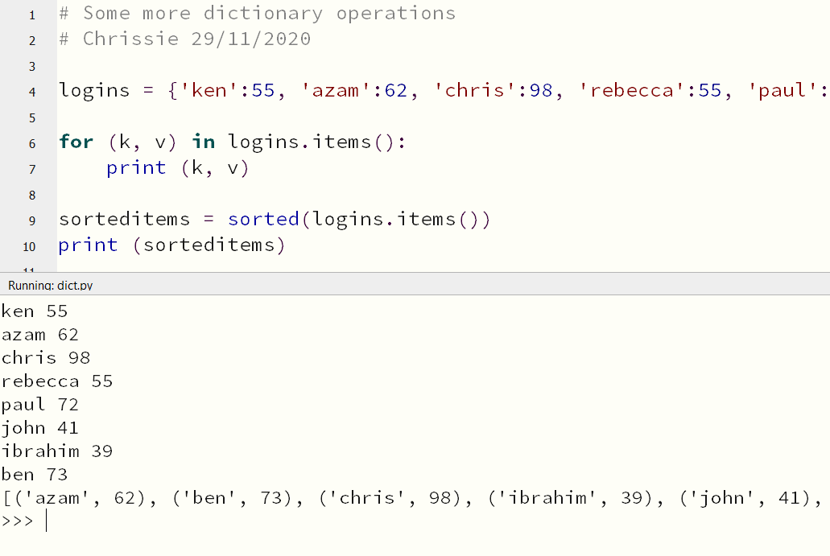
Sorting Lists of Tuples By Key
First, convert the dictionary by using items() and then the sorted() function…

Slide 22
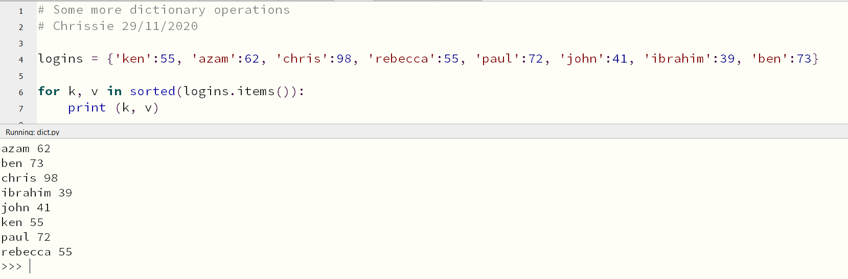
Sorting Lists of Tuples By Key
We can do this even more directly by using a for loop…

Slide 23
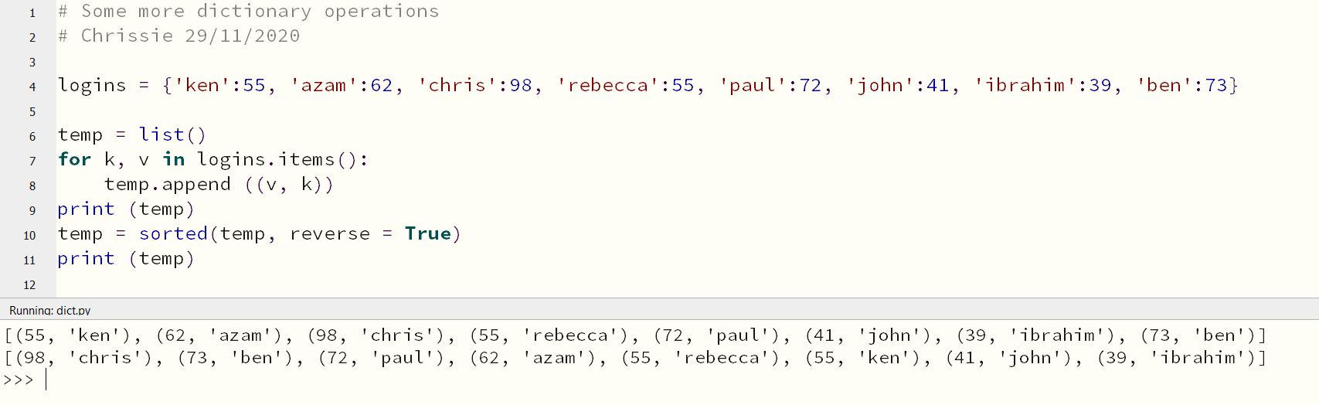
Sorting Lists of Tuples By Value
This is slightly more complicated than sorting by key. It involves making a temporary list of tuples, then appending it with each item as it is sorted by value then key.

Slide 24
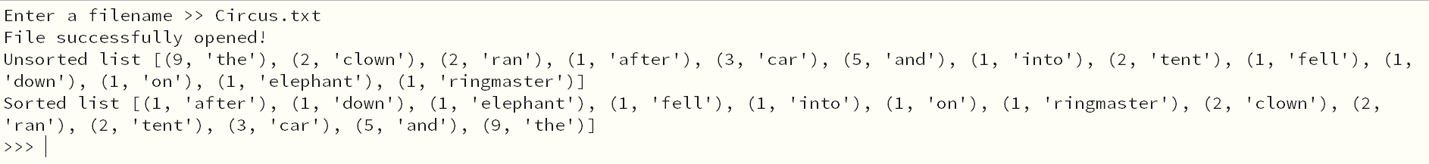
Exercise 1
Download the file handling code from slides 16/17 (wordcount.py).
Amend this to make it print a list of the instances of word occurrences, in ascending order – i.e. all the words which occur once should be at the top of the list, and the most common word should be at the bottom.
It should look something like this for Circus.txt…..

Slide 25
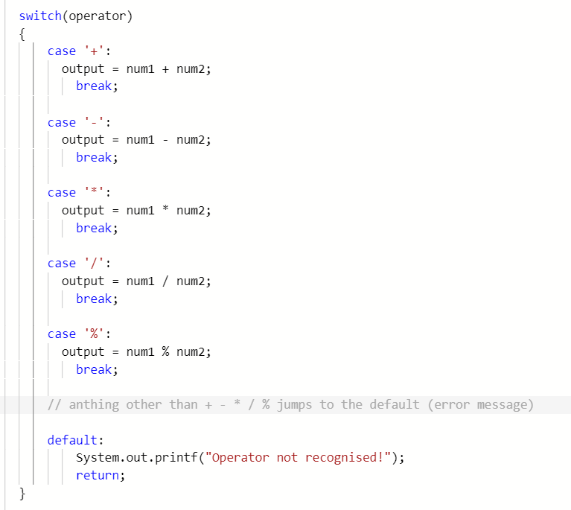
Using a Dictionary as a Switch and Break
Switch-and-break, or switch case statement, is a powerful decision-making construct commonly used in modular programming.
When you don’t want a conditional block cluttered with multiple if conditions, then a switch case is a cleaner way to implement control flow in your program.
Here is an example of a switch-and-break in Java.
Full code for this can be found at https://repl.it/@TheFamousGrouse/WideQuirkyRegister#Main.java

Slide 26
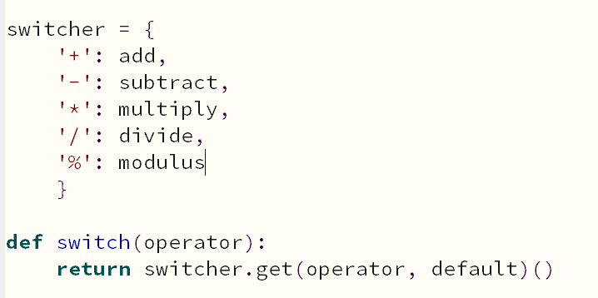
But But But….
Unlike other programming languages, Python doesn’t provide a switch case statement.
Instead, we have to implement our own case statement using one of the other constructs; fortunately this can be easily accomplished by using a dictionary.
If you are keen to know why Python doesn’t have a switch case, then refer to the explanation at PEP 3103.
These are the names of functions…
Full code for this can be found in this week’s bundle – switch.py

Slide 27

Exercise 2
For either the Java or Python version (or both!), add an extra option to the basic calculator. Use the operator ^ (caret, shift+6) to raise the first number to the power of the second one.
To raise a number to a power in Python, use ** (or import math at the top, then use pow(num1, num2))
To raise a number to a power in Java, do this at the top-
import java.lang.Math;
then call Math.pow(num1, num2) to calculate the result.
Finally, add a square root function, using ? for the operator.
To find a square root in Python, import math at the top, then use sqrt(num1)
To find a square root in Java, you should have already added
import java.lang.Math; - now call Math.sqrt(num1) to get the result.

Slide 28

More Python Dictionaries
The final practical assignment will involve building an application with a Python dictionary.
I will not release the fourth practical assessment until week 12.

Slide 29
Further Reading
https://rise.articulate.com/share/Q65g7fNY_sgJqna9VBoodRA4yPfs5IJ7#/lessons/vyBkNiyQO4ZcLO_iJNM8ml2nswnJ3FB8
https://en.wikipedia.org/wiki/Associative_array
These two links are important and you should investigate them before attempting the Multiple Choice.

Slide 30
Thanks For Watching

